Slide 1


Back Up slides Hardware/Software Co-Design
Brian Visas

Slide 2
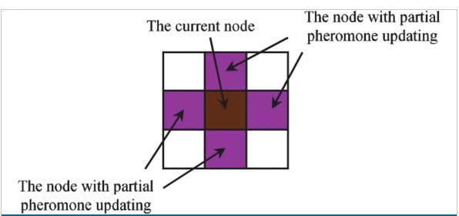
Partial pheromone updating

Slide 3
HIGH LEVEL SYSNTHESIS APPLIED TO ANT COLONY OPTIMIZATION
Genetic Algorithm set up
1.Population size
2.Maximum number of generations.
3. Cross Over Probability
Chromosome encoding
1. Made of two fields
2. Mobility( time interval between ASAP and ALAP)
Clock cycle Encoding
1. Chromosome responds to clock step
2. Excess chromosome production due to timing intervals being used.
3.Minimize number of bits per chromosome

Slide 4
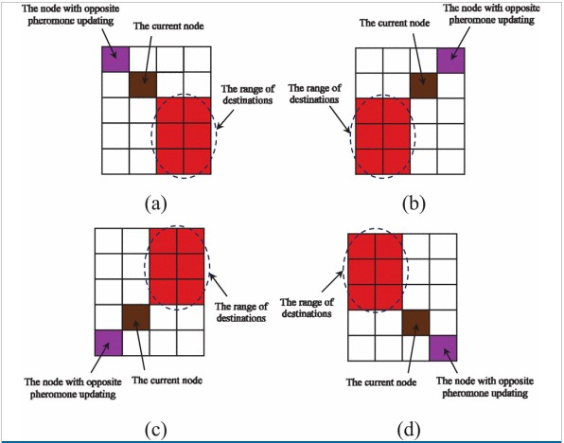
Opposite Pheromone updating

Slide 5
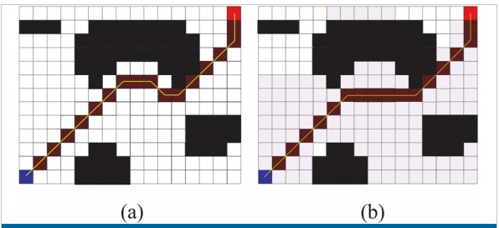
Loca minima Problem

